Slide 1
Hack the Future:
A Gen AI Sprint Powered by Data

Slide 2



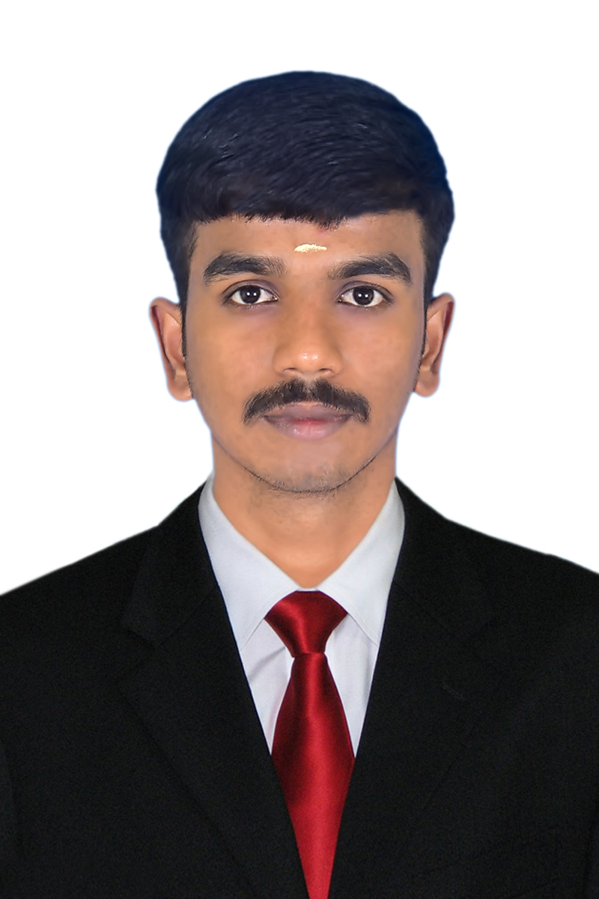
Hack the Future: A Gen AI Sprint Powered by Data
Data and AI Week
Team details
TEAM NAME: Visionary Tech
HARISH BALAJI S

Slide 3
Entry Submission Summary
Idea Title | CareCircle AI Intelligent Wellness for Aging Population
Team Name | Visionary Tech
Problem Statement | Empowering Elderly Care with multi agent AI system
Proposed Solution | A smart AI-based multi-agent system that supports senior citizens by tracking health, medication, activity, nutrition, emotions, and surroundings ensuring safety, independence, and real-time family connectivity via a mobile app.

Slide 4
Problem statement you are trying to address
●Elderly people often struggle with mobility, medication, loneliness, and nutrition, while today’s fast-paced world leaves little time for regular, real-time health monitoring for the elder.
● Health issues like abnormal ECG, low oxygen levels, sleep disturbances, and stress patterns frequently go unnoticed.
● Many also lack motivation for regular physical activity, proper diet management, and social interaction.
● Moreover, monitoring daily activities within the elderly person's living space such as television usage, visitor movement, and surrounding environmental changes is often ignored.
● To address this, we propose a multi-agent AI system to enhance safety, health, and emotional well-being while supporting greater independence for senior citizens.
● The absence of smart technology support often prevents senior citizens from
living safely and independently in their everyday routines.

Slide 5
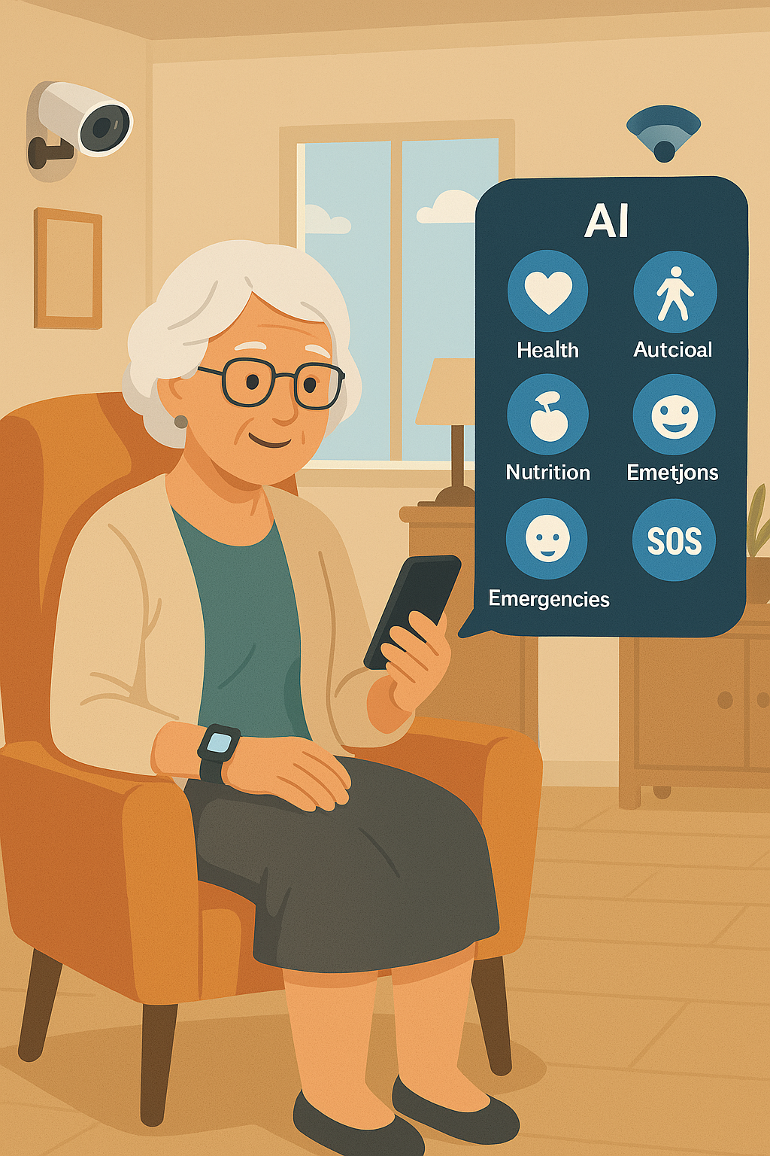
Proposed Solution Overview
● An intelligent Multi-Agent AI system developed to support
elderly care through an easy-to-use mobile application.
● Monitors health, medication, physical activity, nutrition,
emotions, emergencies, and surroundings using smartwatches,
smart devices, and sensors.
● AI provides voice alerts and popup messages to assist the
senior citizen in real time.
● Follows the doctor's instructions and updates treatment or
care routines accordingly
● Unusual events or alerts are privately visible only to family
members for quick response.
● Family members can virtually monitor the senior’s health and
daily progress for better remote support.

Slide 6
Technologies Used
●AI/ML : Random Forest, CNN ,LSTM ,KNN ,Sentiment Analysis.
●NLP: BERT, TextBlob, spaCy, RNN( for voice commands and emotional analysis).
●IoT with smartwatches and sensors for real-time monitoring
●Mobile app: Flutter or React Native
●Cloud computing: AWS,GCP.
●Firebase/MongoDB for secure data storage
●Data visualization: BI, Matplotlib/Seaborn, Grafana, TableauPower
●Security tools: End-to-End Encryption, OpenID Connect, TLS, Data Anonymization & Tokenization

Slide 7
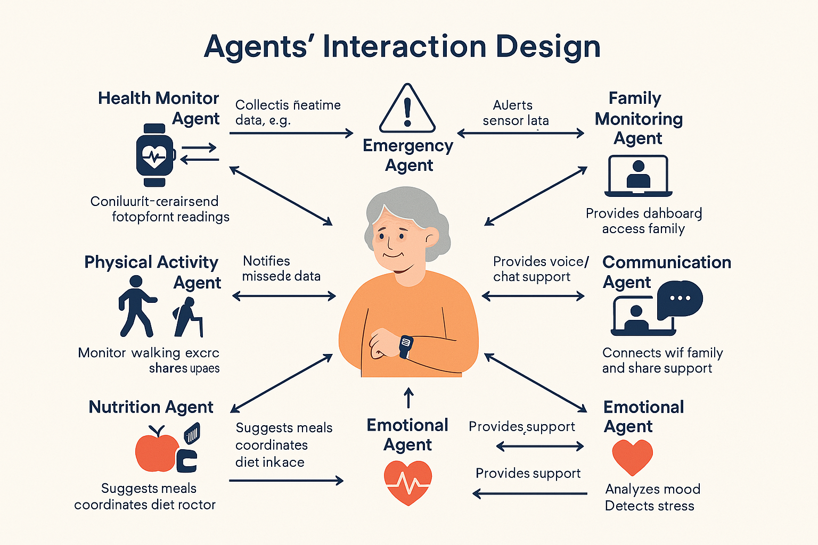
Agents' interaction design
● Nutrition & Activity Agents guide food and exercise based on doctor input.
● Medication Agent sends reminders
and reports missed doses.
● Health Agent monitors vitals and
alerts in case of issues.
● Emergency Agent responds quickly
to critical health alerts.
● Doctor Agent updates health plans
and coordinates with others.
● Family Agent allows virtual monitoring and receives alerts.
Emotional & Communication Agents reduce loneliness and track mood.

Slide 8
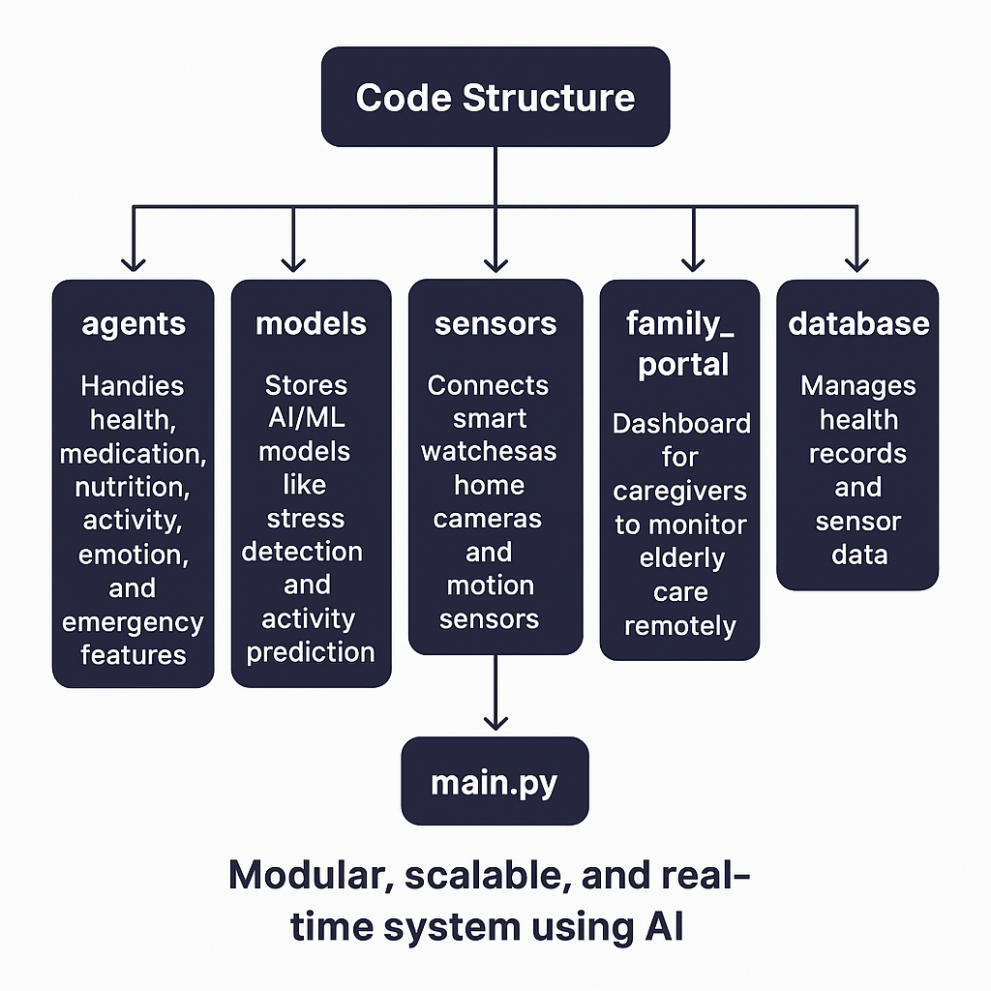
Code structure
● agents/: Handles health, medication, nutrition, activity, emotion, and emergency features.
● models/: Stores AI/ML models like
stress detection and activity prediction.
● sensors/: Connects smartwatches,
home cameras, and motion sensors.
● family_portal/: Dashboard for
caregivers to monitor elderly care.
● remotely.database/: Manages health
records and sensor.
● data.main.py: Runs the entire application.

Slide 9
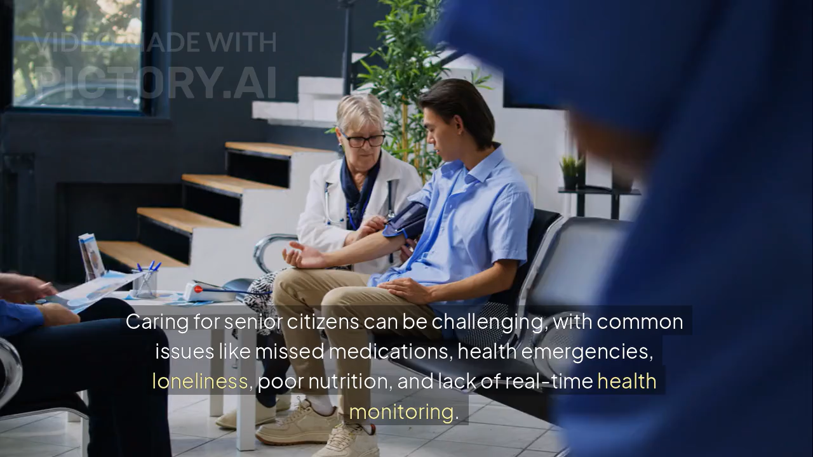
Demo video

Slide 10
Conclusion
●Improves elderly care by continuously monitoring health, medication, and activity.
●Prevents risks by detecting emergencies like abnormal ECG or stress in real time.
●Supports virtual care through a mobile app connecting doctors and family members.
●Reduces loneliness with emotional and communication agents using AI and voice.
●Promotes healthy living with personalized nutrition and exercise guidance.
●Ensures safety with smart sensors, emergency alerts, and secure data access.

Slide 11
References/Other details
● World Health Organization (WHO) – Health Topics: Ageinghttps://www.who.int/health-topics/ageing
● IEEE Xplore Digital Library – Research on Multi-Agent Systems in Healthcarehttps://ieeexplore.ieee.org/
● OpenAI Whisper – Speech Recognition and Communicationhttps://github.com/openai/whisper
● TensorFlow by Google – AI/ML Frameworkhttps://www.tensorflow.org/
● Apple HealthKit – Health Monitoring for iOS Deviceshttps://developer.apple.com/healthkit/

Slide 12

Thank You

